Slide 1
Rifle Platoon Basic Load OEF XII
1/A/2/504 PIR
SSG McCLIMON

Slide 2
The following Paratroopers are equipped with a very light 72hr load. “Snivel, lickies and chewies” have been sacrificed to keep the weight down as much as possible.
They were all weighed wearing their full load and then again without any equipment.
They were weighed carrying all required individual equipment for operations i.e. Goldie, Mine hound, Gizmo, Thor

Slide 3
Average Paratrooper body weight 184.7lbs
Average Paratrooper 72hr kit is 103.69lbs
Paratroopers are carrying 55% of their bodyweight
The recommended fighting load for a conditioned soldier should not exceed 48lbs and the approach march load should not exceed 72lbs (FM 21-18)

Slide 4
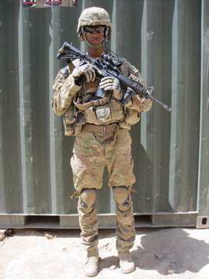
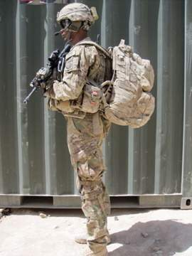
Platoon Leader 96Lbs
M4 (7x30rd Magazines)
PRC-152 (batteries x3)
PVS-20
Trans AP
Pin Flare kit
GPS
VS-17 Panel
Plate Carrier w/ Plates
ACH
Eye Protection
Gloves
Medium Ruck
Knee Pads
Poncho
Poncho Liner
Socks, 1 Pair
Water, 5 liters
MREs, 6 field stripped
Weapons Cleaning Kit
Hygiene Kit
5590 x 2

Slide 5
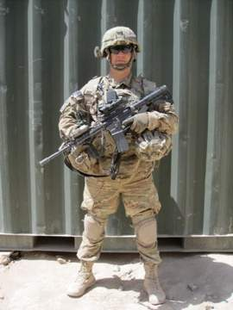
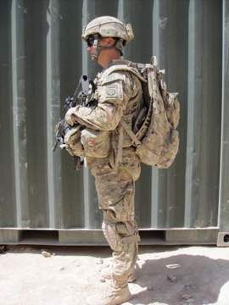
Platoon Sergeant 98Lbs
M4 (7x30rd Magazines)
PRC-152 (batteries x3)
PVS-20
Trans AP
Smoke Grenade
GPS
Plate Carrier w/ Plates
ACH
Eye Protection
Gloves
Medium Ruck
Knee Pads
Poncho
Poncho Liner
Socks, 1 Pair
Water, 5 liters
MREs, 6 field stripped
Weapons Cleaning Kit
Hygiene Kit
5590 x 2

Slide 6
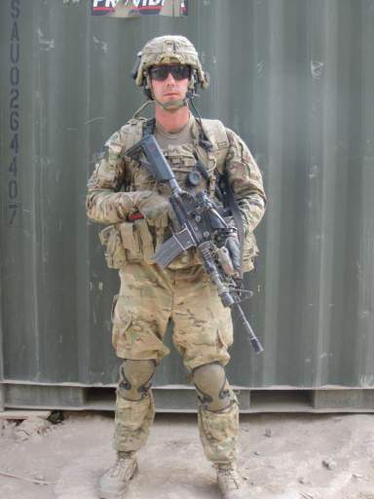
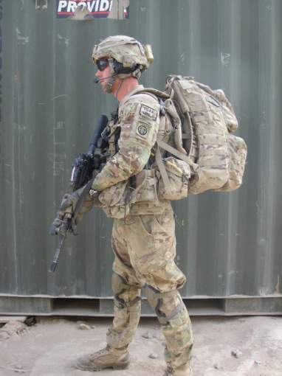
Squad Leader 100Lbs
M4 (7x30rd Magazines)
PRC-152 (batteries x3)
PVS-20
Trans AP
M67 Frag Grenade
Pin Flare kit
Smoke Grenade
HIIDE System
GPS
VS-17 Panel
7.62, 100rds
EPW kit
Plate Carrier w/ Plates
ACH
Eye Protection
Gloves
Medium Ruck
Knee Pads
Poncho
Poncho Liner
Socks, 1 Pair
Water, 5 liters
MREs, 6 field stripped
Weapons Cleaning Kit
Hygiene Kit
5590 x 2

Slide 7
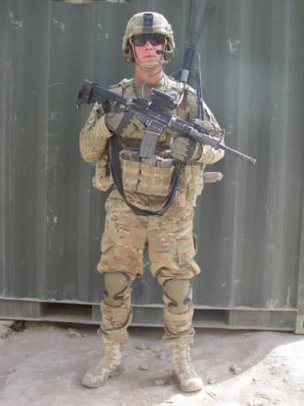
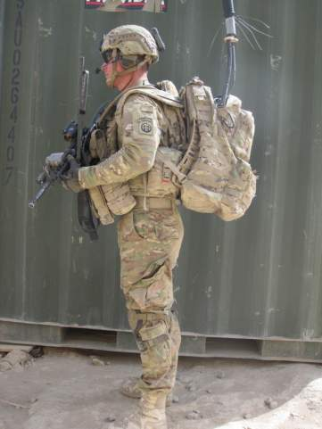
Team Leader 97Lbs
M4 (7x30rd Magazines)
PRC-152 (batteries x3)
PVS-14
M67 Frag Grenade
Smoke Grenade
Thor
GPS
Plate Carrier w/ Plates
ACH
Eye Protection
Gloves
Medium Ruck
Knee Pads
Poncho
Poncho Liner
Socks, 1 Pair
Water, 5 liters
MREs, 6 field stripped
Weapons Cleaning Kit
Hygiene Kit
5590 x 2

Slide 8
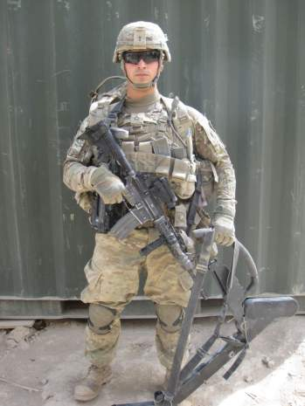
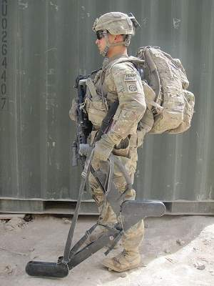
Grenadier 105Lbs
M4 (7x30rd Magazines)
M 320 Grenade Launcher
PVS-14
M67 Frag Grenade
Smoke Grenade
Goldie
40mm, white star cluster x2
40mm, HEDP x 10
Plate Carrier w/ Plates
ACH
Eye Protection
Gloves
Medium Ruck
Knee Pads
Poncho
Poncho Liner
Socks, 1 Pair
Water, 5 liters
MREs, 6 field stripped
Weapons Cleaning Kit
Hygiene Kit
5590 x 2

Slide 9
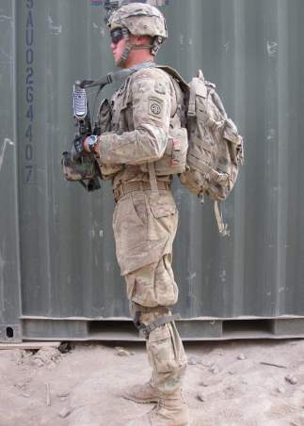
Automatic Rifleman 118Lbs
M249 (800 rounds)
PVS-14
M67 Frag Grenade
Star Cluster
Combat Lifesaver Bag
Plate Carrier w/ Plates
ACH
Eye Protection
Gloves
Medium Ruck
Knee Pads
Poncho
Poncho Liner
Socks, 1 Pair
Water, 5 liters
MREs, 6 field stripped
Weapons Cleaning Kit
Hygiene Kit

Slide 10
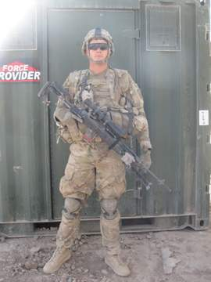
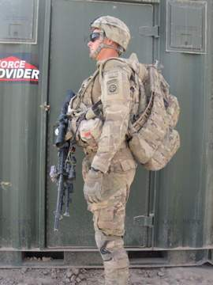
Rifleman/SDM 111Lbs
EBR/M14 (7x20rd Magazines)
PVS-14
M67 Frag Grenade
MineHound
Plate Carrier w/ Plates
ACH
Eye Protection
Gloves
Medium Ruck
Knee Pads
Poncho
Poncho Liner
Socks, 1 Pair
Water, 5 liters
MREs, 6 field stripped
Weapons Cleaning Kit
Hygiene Kit
5590 x 2

Slide 11
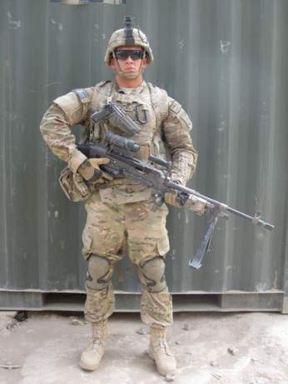
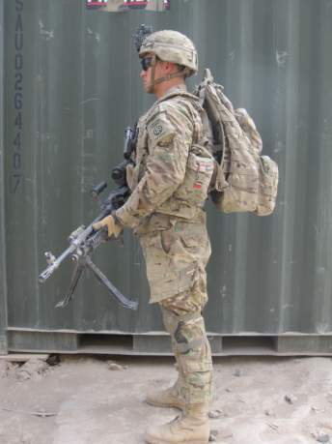
Machine Gunner 103Lbs
M240L (300 Rounds)
M9 (3x15 round magazines)
PVS-14
Plate Carrier w/ Plates
ACH
Eye Protection
Gloves
Medium Ruck
Knee Pads
Poncho
Poncho Liner
Socks, 1 Pair
Water, 5 liters
MREs, 6 field stripped
Weapons Cleaning Kit
Hygiene Kit

Slide 12
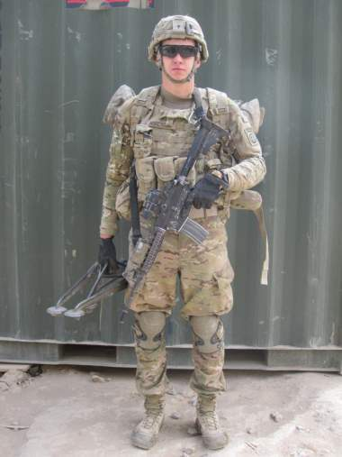
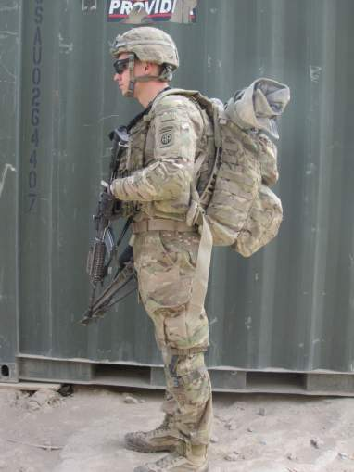
Assistant Gunner 116Lbs
M4 (7x30rd Magazines)
PVS-14
7.62, 400 rounds
Spare Barrel
Tripod
Plate Carrier w/ Plates
ACH
Eye Protection
Gloves
Medium Ruck
Knee Pads
Poncho
Poncho Liner
Socks, 1 Pair
Water, 5 liters
MREs, 6 field stripped
Weapons Cleaning Kit
Hygiene Kit

Slide 13
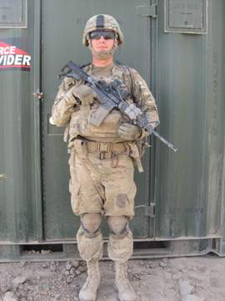
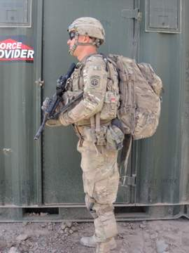
Radio Telephone Operator 119Lbs
M4 (7x30rd Magazines)
PVS-14
ASIP radio
5590 Batteries (4)
SKL
DAGR GPS
Plate Carrier w/ Plates
ACH
Eye Protection
Gloves
Medium Ruck
Knee Pads
Poncho
Poncho Liner
Socks, 1 Pair
Water, 5 liters
MREs, 6 field stripped
Weapons Cleaning Kit
Hygiene Kit

Slide 14
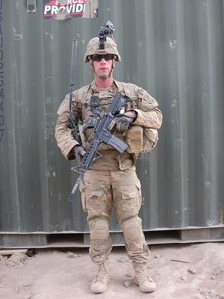
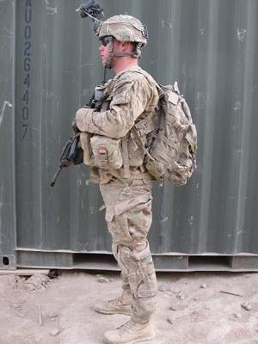
Forward Observer 96Lbs
M4 (7x30rd Magazines)
PVS-14
Smoke Grenade
PRC-152 (batteries x3)
DAGR GPS
VS-17 Panel
Plate Carrier w/ Plates
ACH
Eye Protection
Gloves
Medium Ruck
Knee Pads
Poncho
Poncho Liner
Socks, 1 Pair
Water, 5 liters
MREs, 6 field stripped
Weapons Cleaning Kit
Hygiene Kit
5590 x 2

Slide 15
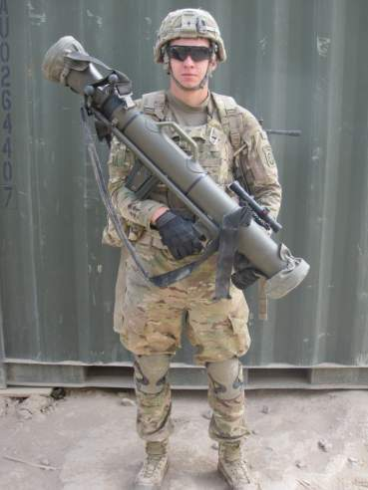
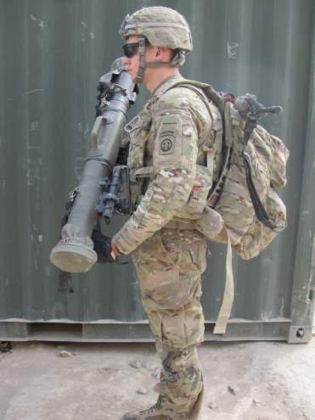
Anti-Tank/M3 Gunner 102Lbs
M4 (7x30rd Magazines)
PVS-14
M3 Carl Gustav (with 4 Rounds)
Plate Carrier w/ Plates
ACH
Eye Protection
Gloves
Medium Ruck
Knee Pads
Poncho
Poncho Liner
Socks, 1 Pair
Water, 5 liters
MREs, 6 field stripped
Weapons Cleaning Kit
Hygiene Kit

Slide 16
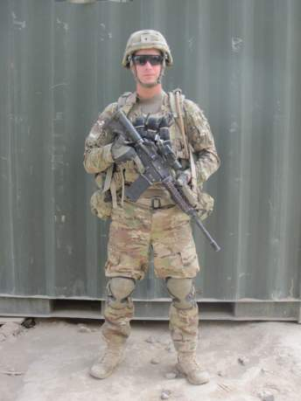
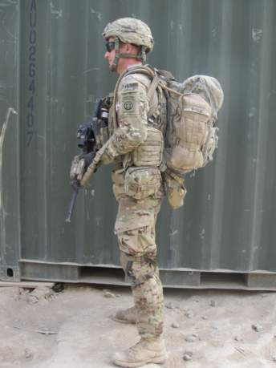
Medic 115Lbs
M4 (7x30rd Magazines)
PVS-14
Aid Bag
Aid Belt
Plate Carrier w/ Plates
ACH
Eye Protection
Gloves
Medium Ruck
Knee Pads
Poncho
Poncho Liner
Socks, 1 Pair
Water, 5 liters
MREs, 6 field stripped
Weapons Cleaning Kit
Hygiene Kit

Slide 17
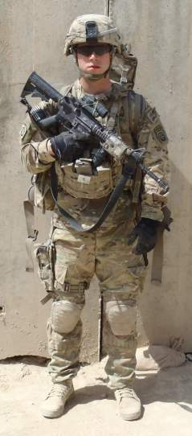
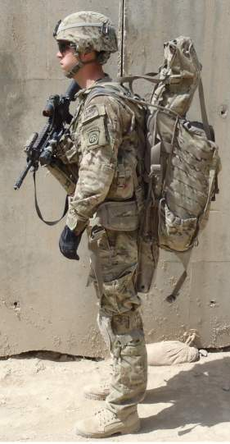
60mm Gunner 115Lbs
M4 (7x30rd Magazines)
PVS-14
M224 60mm Cannon
M9 Baseplate
60mm HE (1rd)
M9 (2 15rds Magazines)
Plate Carrier w/ Plates
ACH
Eye Protection
Gloves
Eberle Stock (gun bag)
Knee Pads
Poncho
Poncho Liner
Water, 5 liters
MREs, 6 field stripped
Weapons Cleaning Kit
Hygiene Kit

Slide 18
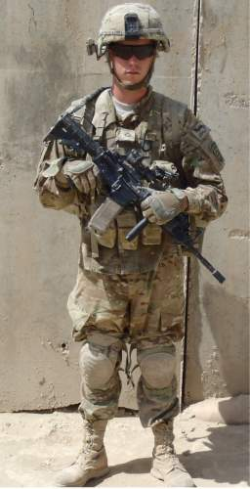
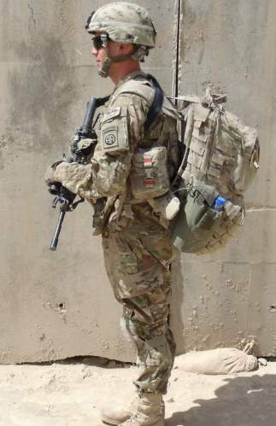
60mm Assistant Gunner 105Lbs
M4 (7x30rd Magazines)
PVS-14
60mm HE (5rds)
Plate Carrier w/ Plates
ACH
Eye Protection
Gloves
Medium Ruck
Knee Pads
Poncho
Poncho Liner
Socks, 1 Pair
Water, 5 liters
MREs, 6 field stripped
Weapons Cleaning Kit
Hygiene Kit

Slide 19
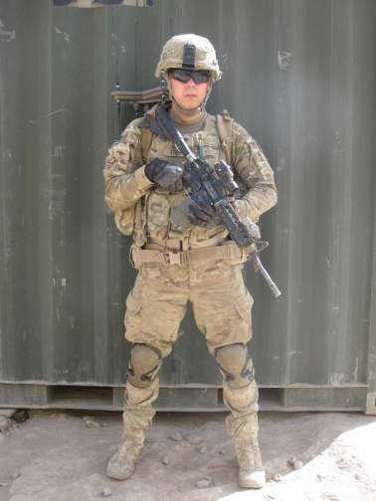
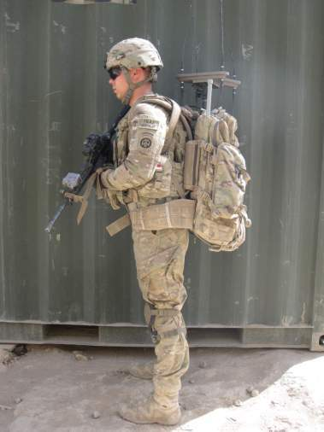
Wolf Hound Operator 112Lbs
M4 (7x30rd Magazines)
PVS-14
Wolf Hound
5590 x 6
Plate Carrier w/ Plates
ACH
Eye Protection
Gloves
Medium Ruck
Knee Pads
Poncho
Poncho Liner
Socks, 1 Pair
Water, 5 liters
MREs, 6 field stripped
Weapons Cleaning Kit
Hygiene Kit

Slide 20
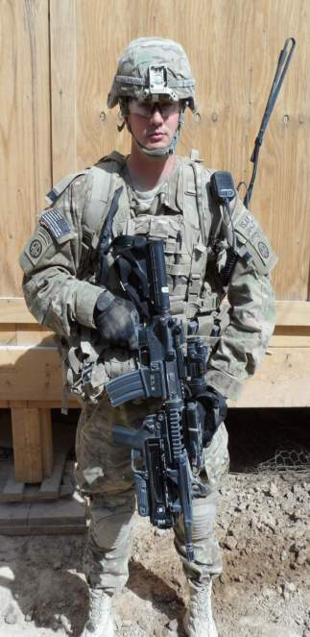
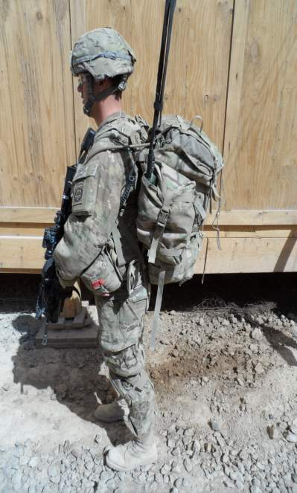
LLVI Team Member 151Lbs
M4 (7x30rd Magazines)
PVS-14
(Ruck 1) PRD-13 Brain w/Antenna
(Ruck 1)5590 Batteries (2)
(Ruck 1) Harris 152
(Ruck 2) DF Antenna w/cable
(Ruck 2) Binoculars
(Ruck 2) 5590 Batteries (6)
Plate Carrier w/ Plates
ACH
Eye Protection
Gloves
Medium Ruck
Knee Pads
Poncho
Poncho Liner
Socks, 1 Pair
Water, 5 liters
MREs, 6 field stripped
Weapons Cleaning Kit
Hygiene Kit

Slide 21
Weight Variation from OEF III to OEF XIII
Items like t-shirts, Bivy bag, bayonet, sling rope, sleeping pad, fleece cap, entrenching tools, demolitions, CW gloves, 500ml intravenous fluid bag, M117 claymore mines, and a 60mm rounds are not usually carried by platoons during OEF XIII.
The PL, PSG, SL’s, TL’s, GRN’s, R’s, and FO all carry 2 5590 batteries (6 lbs) for the Thor system. For a total 36 batteries (108 lbs!) per platoon. Which allows each Thor system to run for roughly 21hrs during the 72hr operation.
Grenadiers are carrying 10 HEDP as opposed to 26 HEDP(OEFIII). Instead they carry the Goldie and batteries.
The AT gunner carries the M3 CG with 4 rounds as opposed to the Javelin with 1 round. (the M3 needs to be adopted into the MTO&E, it is an outstanding weapon with a wide variety of rounds like Anti-Armor, HE, Airburst, and ASM. It would be a great addition to a Rifle Platoon)
Force cap has reduced the size of the infantry platoon. The overall weight carried by the individual would be lower, but due to being force capped most rifle squads are running at 7 men. Machinegun teams are either 2 or 3 men. This leaves most platoons around 28 personal instead of the 40 they would usually have.

Slide 22
Platoon Headquarters

Slide 23
Rifle Squad with MG

Slide 24
Anti-Tank, 60mm Mortar & WolfHound

Slide 25
Conclusion
While new materials and designs have reduced the basic equipment weight carried, the addition of special of equipment i.e. Thor, Mine Hound, Gizmo, Goldie and Wolf Hound has increased our overall weight. The ability to find IEDs, caches and intercept enemy communications is a combat multiplier but they have also negated the weight saved from newer designs/materials.
Body armor weight has gone from 17.50lbs to 28lbs due to the addition of side plates and the upgrade to E-SAPI plates.
Due to the sensitive nature and the necessity to have the equipment on you for it to function (Thor, wolfhound etc) storing rucks in a cache at an ORP is not an option. When contact is made maneuver is difficult. AWT, CAS and Indirect fires are relied upon heavily to destroy the enemy.

Slide 26
Online resources
Report on 2/504 PIR during OEF III about weight carried during operations
http://thedonovan.com/archives/modernwarriorload/ModernWarriorsCombatLoadReport.pdf
Online FM 21-18 Foot march
http://www.enlisted.info/field-manuals/fm-21-18-procedures-and-techniques-of-foot-marches.sh

